Slide 1
PSI Build Monitor using Raspberry PI
Priyanka Raghavan

Slide 2
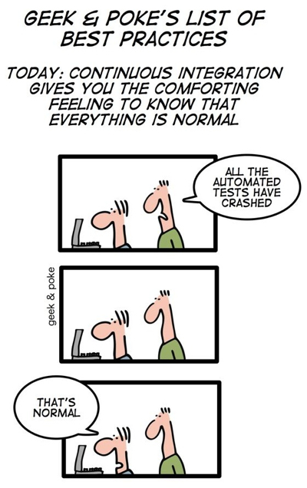
I want to know “Build Quality”
Typical scenario of the manager walking into your office to find out build quality.
You immediately scramble to open up your TFS build notification toolbox and show the status.
Imagine a scenario where he enters your office and sees the wall with a bulb or an LED strip glowing that tell him the status instantly. Another idea is that possibly he could have this strip in his office so he only visits you when it’s red☺

Slide 3
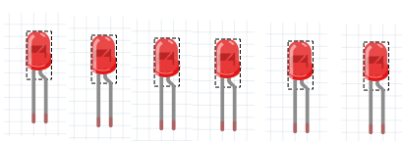
The idea
Have a service that monitor latest TFS builds for PSI or any WG project
Transmit this build status information to Raspberry PI
Raspberry PI uses build status to light an LED.
Red light is failure
Green light is success
PSI
PSI
SDM
FWIQC
SVM
OC

Slide 4
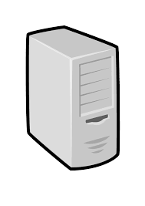

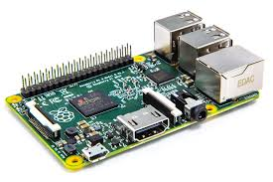
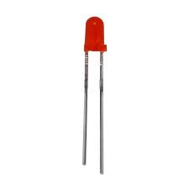
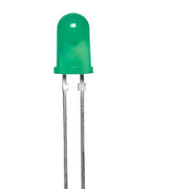
Implementation
TFS build server
Create a TFS build monitor that uses TFS API to query PSI builds (Microsoft.TeamFoundation.Build.Client)
Use simple TCP server socket to transmit status to Raspberry PI (TcpListener)
Raspberry PI socket client receives message from TCP server
LEDs are turned on based on status
Monitor and get results
Pass build status
Raspberry PI 2
Laptop
Turn on/off LEDs

Slide 5
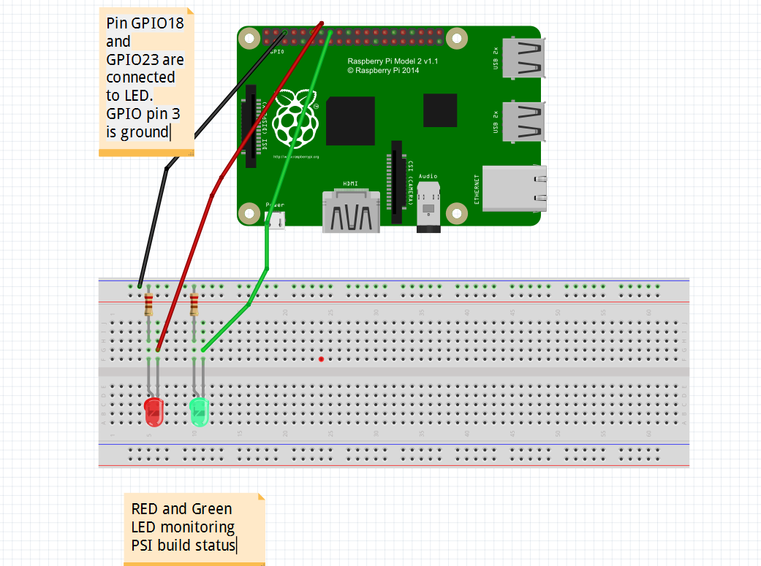
Circuit breadboard diagram

Slide 6
Future
Replace LEDs with a LED strip
Non addressable LEDs fixed color. So each strip is for one build definition
Addressable LED strips
Each individual LED can be programmed to emit light red,green etc
We can monitor many build definitions
Modify post build event to send message to Raspberry PI
Move to publish/subscribe model by using some messaging queue like zero MQ for publishing build status. Possibly use google cloud platform like gprc
Good if we have many PI in the office

Slide 7
Man hours and maintenance cost
Modify post build events to publish build messages using messaging platform like gprc
Learning about GPRC – 1 week (40 hours)
Trying to modify build script and publishing results- 3 days (24 hours)
Reading message on PI and lighting LED day 2 days (16 hours)
Changing from LED to LED strip- 2 weeks (80 hours)
Maintenance of project – Maybe 1/2 day a week (4 hours)

